Slide 1
Introduction to Bing Maps
January 2015

Slide 2
Intermediate Cover Title
Intermediate Cover Subtitle

Slide 3
Title
Body text 1st layer
Body text 2nd layer
Body text 3rd layer
Body text 4th layer
Body text 5th layer

Slide 4
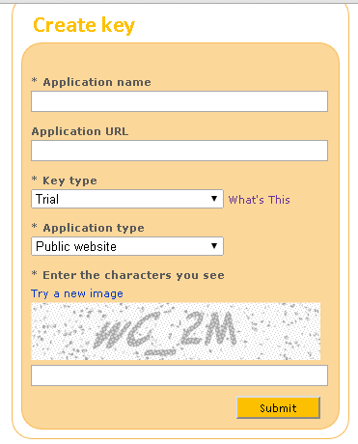
Registration
Request a Key (Credential)
Microsoft Live Account
Bing Maps Website
Create a Trial or Basic Key

Slide 5
API Types of Bing Maps
REST (REpresentational State Transfer) Services for Web, Mobile and Desktop
AJAX (Asynchronous Javascript And eXtensible Markup Language) SDK for Web and Mobile
Windows Store Apps for Desktop
Spatial Data Services for Web, Mobile and Desktop (Win 8+)
Windows Presentation Foundation for Desktop

Slide 6
RESTful Web Service
Features: Simple, Lightweight and Fast
Resource Identification through Uniform Resource Identifier
e.g. http://localhost:8080/RESTDemo/book/all or http://localhost:8080/RESTDemo/book/123-0-321-12345-0
Uniform Interface (HyperText Transfer Protocol)
Post/Create, Get/Read (safe, idempotent, cacheable), Put/Update (idempotent), Delete(idempotent), Head(safe, idempotent)
Self-descriptive Messages/Data
JavaScript Object Notation, XML, HyperText Markup Language, Text…
Stateless

Slide 7
Bing Maps REST Services
Locations API
Find a Location By Address, Point or Query
Structural URL
http://dev.virtualearth.net/REST/v1/Locations/CA/adminDistrict/postalCode/locality/addressLine?includeNeighborhood=includeNeighborhood&include=includeValue&maxResults=maxResults&key=BingMapsKey
Unstructural URL
http://dev.virtualearth.net/REST/v1/Locations?countryRegion=countryRegion&adminDistrict=adminDistrict&locality=locality&postalCode=postalCode&addressLine=addressLine&userLocation=userLocation&userIp=userIp&usermapView=usermapView&includeNeighborhood=includeNeighborhood&maxResults=maxResults&key=BingMapsKey
Data Format: JSON, XML…
Elevations API
Imagery API
Routes API
Traffic API

Slide 8
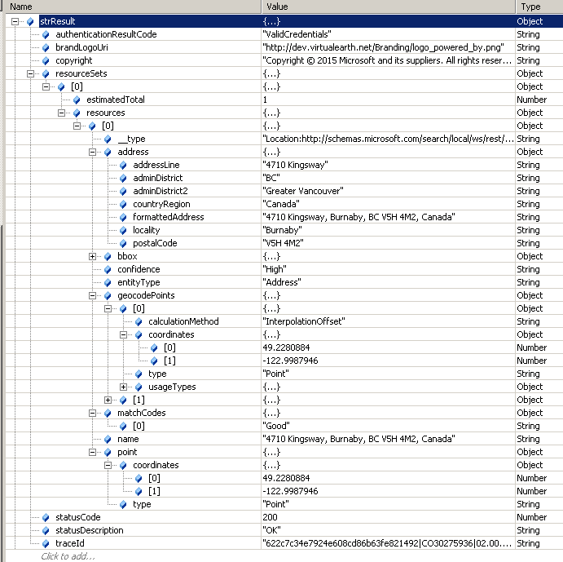
REST Data Example
Location Result from Finding Location By Address

Slide 9
AJAX SDK
Technology
HTML
JavaScript (jQuery)
Cascading Style Sheets

Slide 10
AJAX Control Implementation of Bing Maps
Load Map Control
<!DOCTYPE html PUBLIC "-//W3C//DTD XHTML 1.0 Transitional//EN" "http://www.w3.org/TR/xhtml1/DTD/xhtml1-transitional.dtd">
<html>
<head>
<meta http-equiv="Content-Type" content="text/html; charset=utf-8"/>
<script charset="UTF-8" type="text/javascript" src="http://ecn.dev.virtualearth.net/mapcontrol/mapcontrol.ashx?v=7.0&s=0&mkt=en-us">
</script>
</head>
… …

Slide 11
AJAX Control Implementation of Bing Maps
Create a Map
<script type="text/javascript">
var map = null;
function getMap() {
map = new Microsoft.Maps.Map(document.getElementById("mapDiv"),
{credentials:“key…"});
}
</script>
Load the Map
<body onload=“getMap();">
… …
<div id='mapDiv' style="position:absolute; width:400px; height:400px;"></div>
</body>

Slide 12
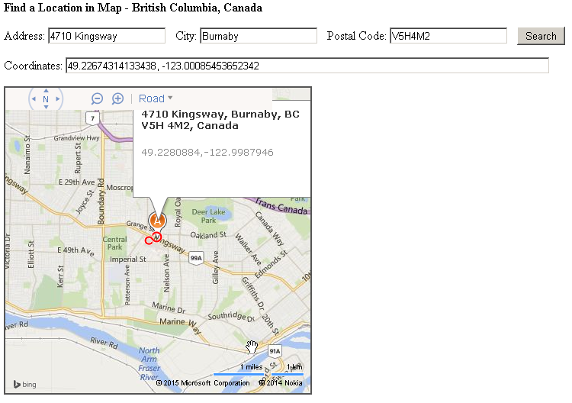
Demo and Code Review
Display Bing Map by Bing Maps AJAX Control v7.0
Invoke Bing Map REST service to find a location by address
Display location information

Slide 13
References
http://msdn.microsoft.com/en-us/library/dd877180.aspx
http://docs.oracle.com/javaee/6/tutorial/doc/gijqy.html
http://vivien-chevallier.com/articles/use-bing-maps-rest-services-with-jquery-to-build-an-autocomplete-box-and-find-a-location-dynamically
Google and StackOverflow

